Slide 1
Technology Transformation Project
Patrick Desbrow
Analyze Phase Tollgate Review

Slide 2
BPM Project Summary
Problem Statement
The Client System Group (CSG) spends approximately 277 hours or $25,000 to deliver a single study on the existing Compass web deliverable.
There are too many individual steps in a single study. The existing process is manual and requires a great deal of checking to ensure accuracy. In addition, it is also susceptible to errors and potential rework.
Metric
Y1: Labor hours per syndicated study
Defect Definition
D1: Total time > Labor Hours
D2: # of Errors
Objective
Currently a syndicated study in the Insurance practice area takes approximately 277 hours of IT labor to deliver on the Compass web site. The aim is to:
  Decrease this by 72% or 200 hours of labor for a syndicated research study.
Current Baseline
Average labor hours for creating and checking study deliverables: 277 labor hours
2.0 person programming teams work on each study implementation
All hardware and software costs are part of the Solution Framework project
Projected Benefits
Based on project chargeback rates per hour, There will be a cost saving of $15,433 per study implementation
There is at least $100,000 savings if only seven to nine current insurance practice area studies move over to this new process
Copyright © 2001-2007
Six Sigma Academy International, LLC
All Rights Reserved
JDPA – Insurance Practice Business Process Redesign

Slide 3
Analyze Key Accomplishments
Validate the quick win process for saving QA testing time for the project
Developed use case scenarios that focused on the area for improvement
Completed data collection and established baseline performance
Completed review of the preliminary business case with I&M Finance
Developed a detail project plan including BPM Milestones and Core Team meeting updates
Refined existing business process map to identify specific areas of opportunity
  Focused opportunities on the work associated with producing and verifying client deliverables
Conducted measurement analysis to validate the procedures and practices for recording actual labor hours
Developed preliminary business case on the benefits impacting the business
Copyright © 2001-2007
Six Sigma Academy International, LLC
All Rights Reserved
JDPA – Insurance Practice Business Process Redesign
Notes:
The initial project charter was still rather broad – identifying a need for improvement within the broad spectrum of executing a mail-based study. In that regard, it was important for us to walk through the process and talk to process owners, practice leads, and research project managers to identify the key stakeholders and internal customers. This helped us understand the pain points throughout the process
From the walk-through and interviews, we learned a few things:
1. The existence of a number of handoffs and verification steps that have been institutionalized in our processes
2. An understanding of how scope of work changes and input variation impact our Client Operations (i.e. research production) activities, and
3. The type of data available and necessary for us to gather and analyze in order to prioritize our pain points

Slide 4
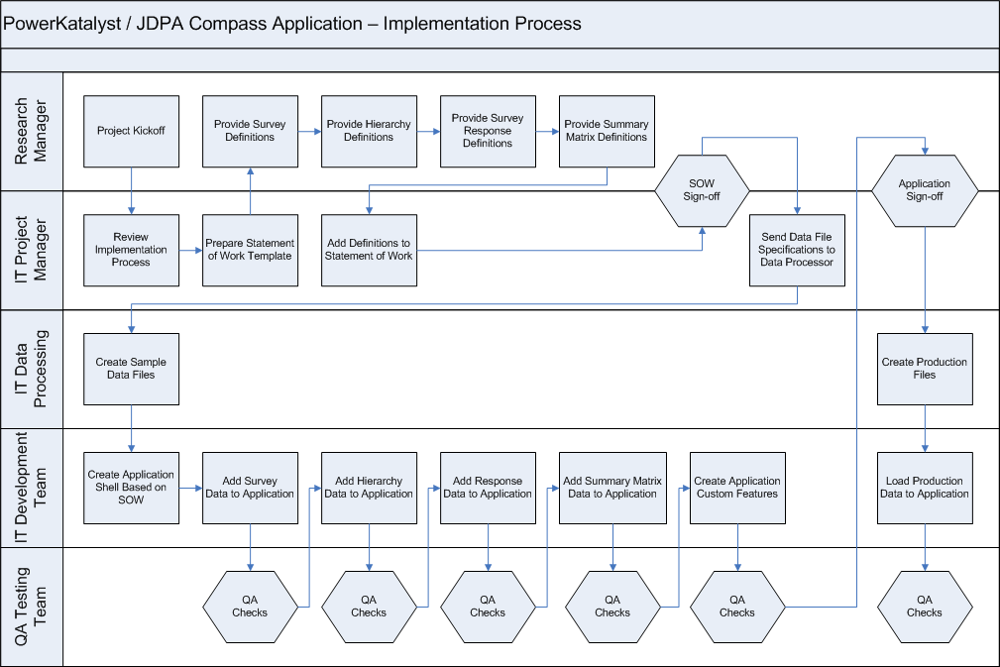
Detail Process Map
1
2
3
4
5
= Opportunities
Copyright © 2001-2007
Six Sigma Academy International, LLC
All Rights Reserved
JDPA – Insurance Practice Business Process Redesign
Notes:
The initial project charter was still rather broad – identifying a need for improvement within the broad spectrum of executing a mail-based study. In that regard, it was important for us to walk through the process and talk to process owners, practice leads, and research project managers to identify the key stakeholders and internal customers. This helped us understand the pain points throughout the process
From the walk-through and interviews, we learned a few things:
1. The existence of a number of handoffs and verification steps that have been institutionalized in our processes
2. An understanding of how scope of work changes and input variation impact our Client Operations (i.e. research production) activities, and
3. The type of data available and necessary for us to gather and analyze in order to prioritize our pain points

Slide 5
Opportunities
Creating the Project Statement of Work (Requirements Gathering)
    Each project can have a high degree of customization
    This requires a detail project requirements document or SOW
    This document is design to control scope and reduce variations between studies
    The project aims to eliminate the need for a detailed statement of work process
Adding Survey Questionnaire Information to Application (Load Data)
    Programmers currently needs to manually setup survey questionnaire data
    This step begins with the instructions provided by the research project team
    Programmers then map and format the survey questions
    This process may go through a number of cycles
Adding Hierarchy Data to Application to Application (Load Data)
    Programmers currently need to manually load the study hierarchy information
    Programmers map and format this data as well
    This process also goes through a number of cycles
Copyright © 2001-2007
Six Sigma Academy International, LLC
All Rights Reserved
JDPA – Insurance Practice Business Process Redesign

Slide 6
Opportunities
Adding Summary and Detail level to Application (Web Site Presentation)
    Programmers currently need to manually load the respondent level data
    and summary data such as index scores
    Programmers map and format this data as well
    This process also goes through a number of cycles
Numerous QA Testing Checks Through the Process (QA Web Site)
    There is a quality assurance test step for each of these manual processes
    The aims is to reduce the amount of testing before a study is delivered
Copyright © 2001-2007
Six Sigma Academy International, LLC
All Rights Reserved
JDPA – Insurance Practice Business Process Redesign

Slide 7
Project Roadmap
2007 Syndicated Study Average
277 Hrs (per study)
Out of Scope
In Scope
77 Hrs (28%)
200 Hrs (72%)
Essential Project Management
Hosting
QA Testing
Global Enhancements
Client Deliverables
Business-defined Pain Point
Priority Focus
Gather Requirements
Load Data
Create Web Site Presentation
QA Web site
Release Study
40 Hrs (20%)
40 Hrs (20%)
80 Hrs (40%)
25 Hrs (13%)
15 Hrs (7%)
Detailed Process Map
Value Stream Map
Root Cause Analysis
Detailed Process Map
Value Stream Map
Root Cause Analysis
Detailed Process Map
Value Stream Map
Root Cause Analysis
Lower Priority
Next steps focused on analyzing why it takes time to create and verify Compass and Report deliverables
Copyright © 2001-2007
Six Sigma Academy International, LLC
All Rights Reserved
JDPA – Insurance Practice Business Process Redesign

Slide 8
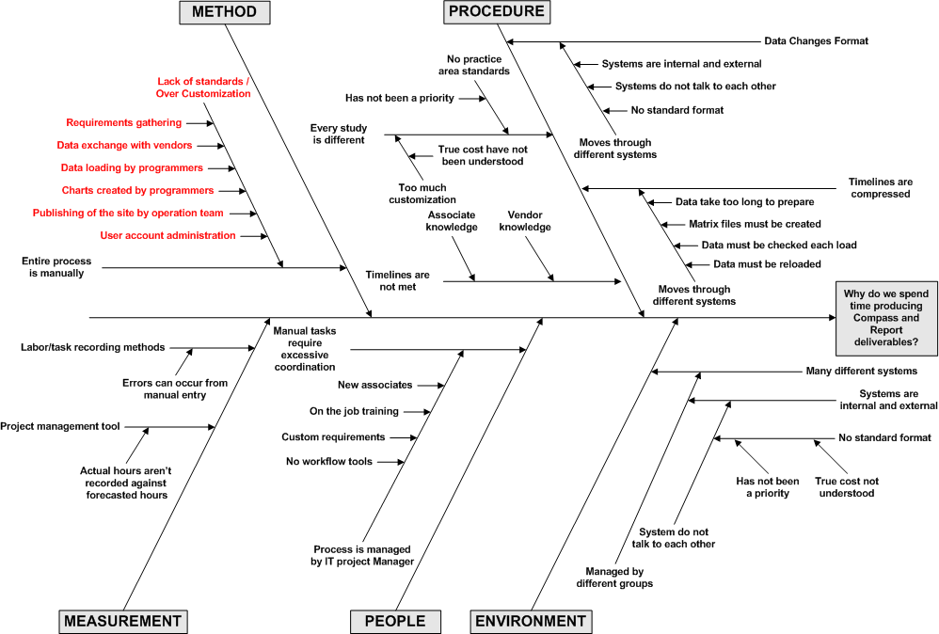
Cause & Effect Diagram – Why is time being spent?
Back-office tools would enable greater automation of the process and reduce labor hours
Cause & Effect Analysis qualitatively supports opportunities based on automation of tasks
Copyright © 2001-2007
Six Sigma Academy International, LLC
All Rights Reserved
JDPA – Insurance Practice Business Process Redesign

Slide 9
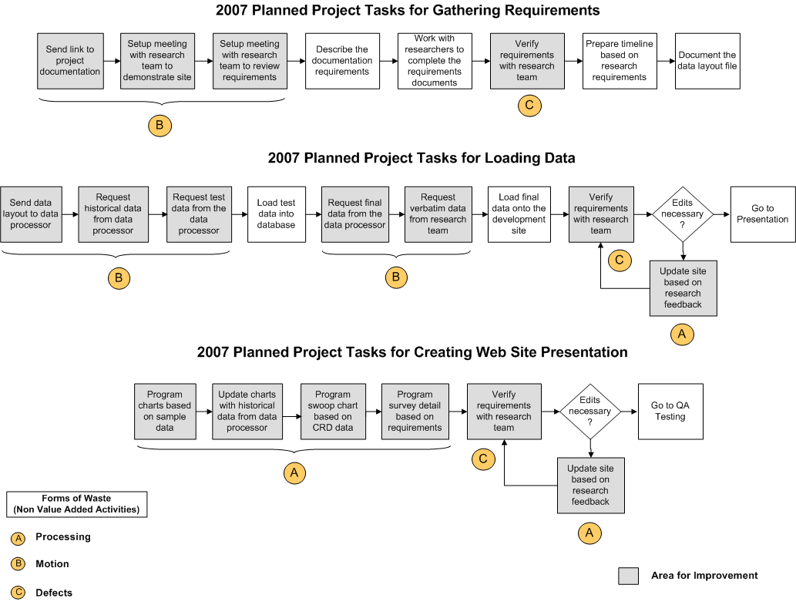
Value Stream Map – Where is time being spent?
30 Hrs (75%) of the time spent gathering requirements is non value added activities.
30 Hrs (75%) of the time spend load data is non value added activities.
60 Hrs (75%) of the time spend creating the web site presentation is non value added activities.
There are a number of areas for improvement
The gray boxes emphasize the need for a new process and new tools that support automation.
Copyright © 2001-2007
Six Sigma Academy International, LLC
All Rights Reserved
JDPA – Insurance Practice Business Process Redesign

Slide 10
Analysis Findings
Labor hour drivers
  Requirements gathering steps
  Data loading steps
  Creation of the web site presentation
Other drivers of waste
  There are a number of communication steps
  Process is managed by IT project managers
  Data is load several times
  Requirements changes throughout a studies lifecycle until published
Extensive data verification is required due to the manually intensive processes involved
Research team should capture the quality metrics for each study to determine the relationship of standardization to overall project quality
Copyright © 2001-2007
Six Sigma Academy International, LLC
All Rights Reserved
JDPA – Insurance Practice Business Process Redesign

Slide 11
Critical Root Causes & Effects
Original Issue | Root Cause | Benefit of Correction
The procedural tasks for gathering requirements is time consuming and varies from study to study | Gather requirement is a manual task that must be guided by an IT Project Manager. There are a number of non-value added tasks in this process. Labor variation is driven by the complexity of the study | Automating the requirements gathering steps will reduce the labor variation caused by study complexity and eliminate the non-value added tasks.
The procedural tasks for loading data is time consuming and varies from study to study | Loading data is a manual task that must be completed by a programmer. Formats are nonstandard and require human intervention. Data is must be reloaded based on changes from the research team. | Standardizing the data formats and automating the data loading process will reduce the labor hours and reduce eliminate non-value added work. The quality levels of each deliverable will also go up and reduce the number of reloads.
The procedural tasks for creating the web site presentation is time consuming and varies from study to study | The web site presentations tasks is a manual process that must be completed by a programmer. Presentations are nonstandard and require human intervention. Charts and tables are updated based on the data reloads. | Creating standards around charting and data table presentations will enable tools to be developed that can remove the programmer from the implementation process.
Copyright © 2001-2007
Six Sigma Academy International, LLC
All Rights Reserved
JDPA – Insurance Practice Business Process Redesign

Slide 12
Initial Improvement Recommendations
Reduce or eliminate the manual steps in the current process
  Gather requirement
  Loading data
  Creation of presentation deliverables (charts, reports, etc…)
Standard common functions to remove the need for manual intervention in the process
Propose and test the development of back-office tools to automate the new process
Examine the quality metrics for each study to verify that quality does up when the recommended improvements put in place
Copyright © 2001-2007
Six Sigma Academy International, LLC
All Rights Reserved
JDPA – Insurance Practice Business Process Redesign

Slide 13
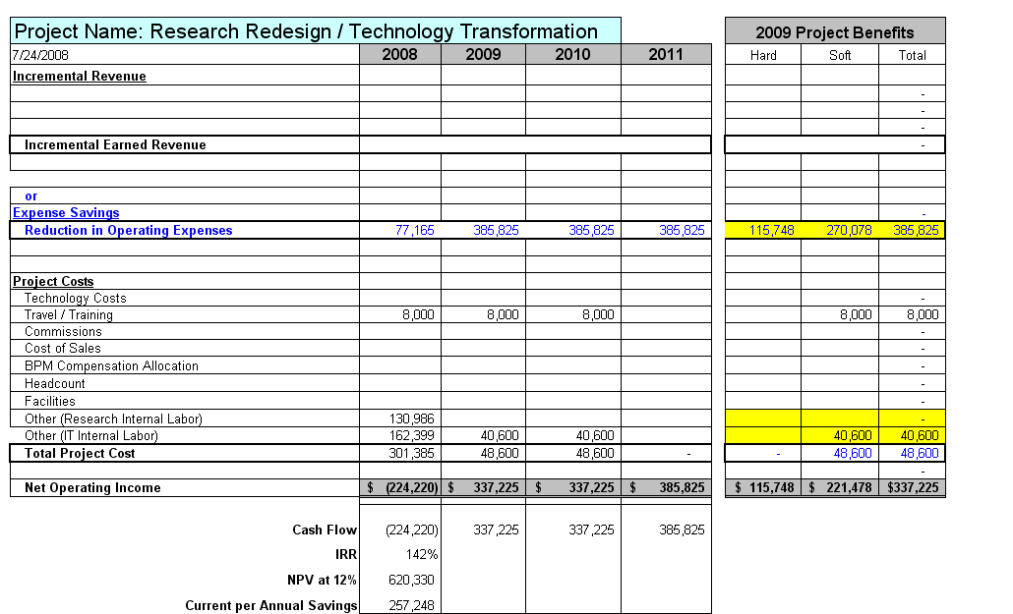
JDPA Business Case Summary
Copyright © 2001-2007
Six Sigma Academy International, LLC
All Rights Reserved
JDPA – Insurance Practice Business Process Redesign

Slide 14
Assumptions
Labor Improvement Assumptions
Improvement in IT labor hours (72%) associated with the following activities:
  Reducing project management
  Eliminating data loading tasks
  Reduce chart creating and presentation tasks
Cost Savings Assumptions
Reduce labor by 200 hours per project
$15,433 cost saving per study
5 projects in 2008, 25 project each year after
Resource Assumptions
No additional Insurance practice labor hours/costs after 2008
There will be additional IT development costs in 2008 & 2009 related to efforts for other practice areas
30 % of the contract resources will be retired resulting in a hard cost saving of $115,748 in 2009.
All other resources will moved to other projects
Other Assumptions
Travel: $1000/trip x 2 trips x 2 employees = $4,000
Training: $1,000/session x 4 sessions = $4,000
No software or hardware costs. (These costs are part of the Solution Framework project)
Copyright © 2001-2007
Six Sigma Academy International, LLC
All Rights Reserved
JDPA – Insurance Practice Business Process Redesign

Slide 15
Next Steps
Project Task Owner Target Date
Document Improvement Actions BPM Team 2/15/09
Conduct and Document FMEA BPM Team 2/15/09
Finalize Reporting & Chart Templates Research 1/15/09
Web Site Version 1 IT 2/20/09
BPM Control Phase/Handoff BPM Team 2/20/08
Finalize Reporting & Chart Documentation Research 2/20/08
Web Site Version 2 IT 2/20/08
Web Site Auditing and Validation Research 3/01/08
Copyright © 2001-2007
Six Sigma Academy International, LLC
All Rights Reserved
JDPA – Insurance Practice Business Process Redesign

